Slide 1
Python Project Assignment #3
By Michael Sanchez

Slide 2
Project Game : Mis/In/Formed
Puzzle Simulation
Gameplay: Point and Click
Goals:
Overall Goal: a narrative surrounding Misinformation and Human AI
Second Overall Goal: Python skills, and demonstration of understanding using python libraries (Mostly PyGame at current state)

Slide 3
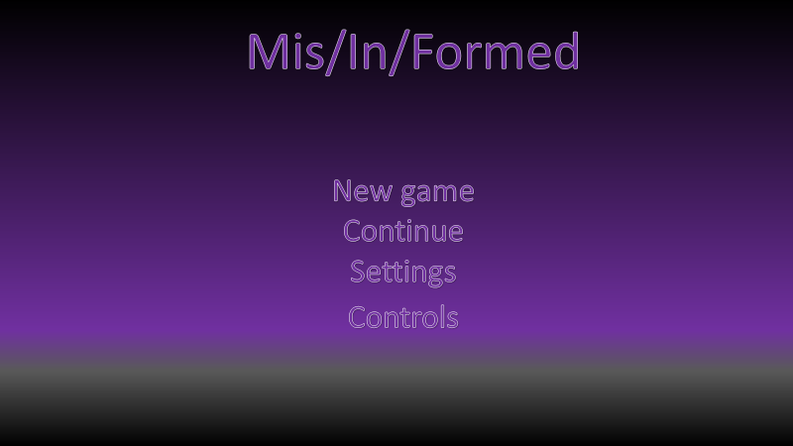
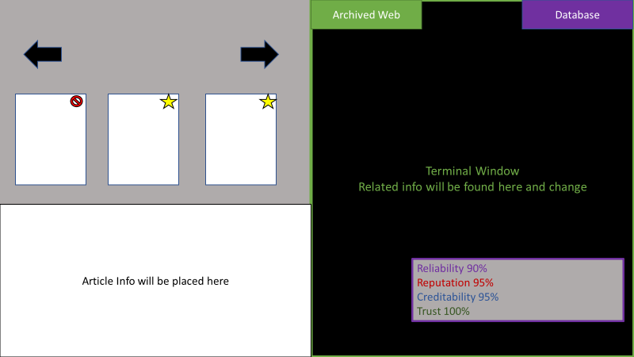
Concept Art

Slide 4
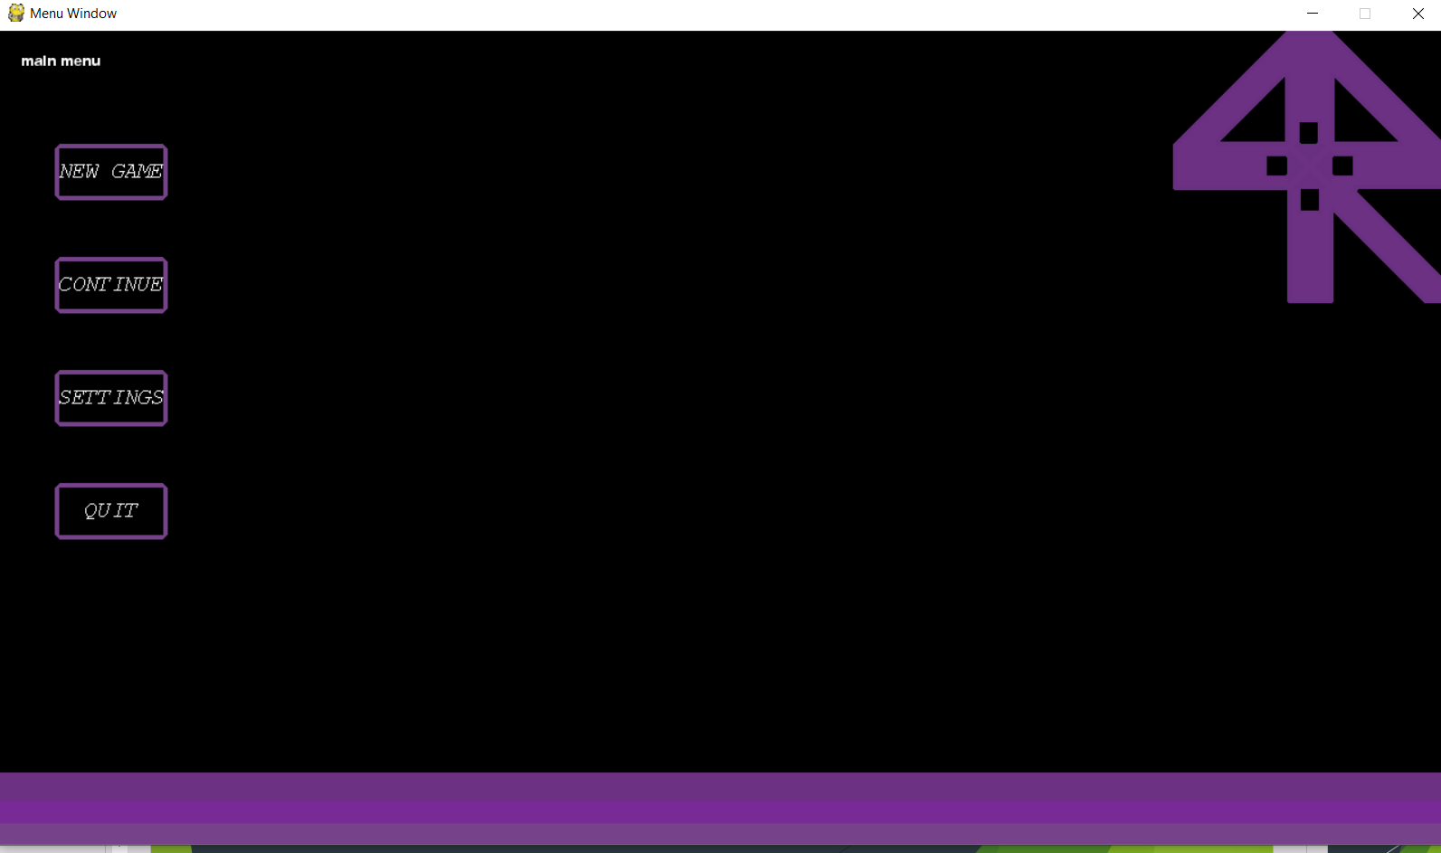
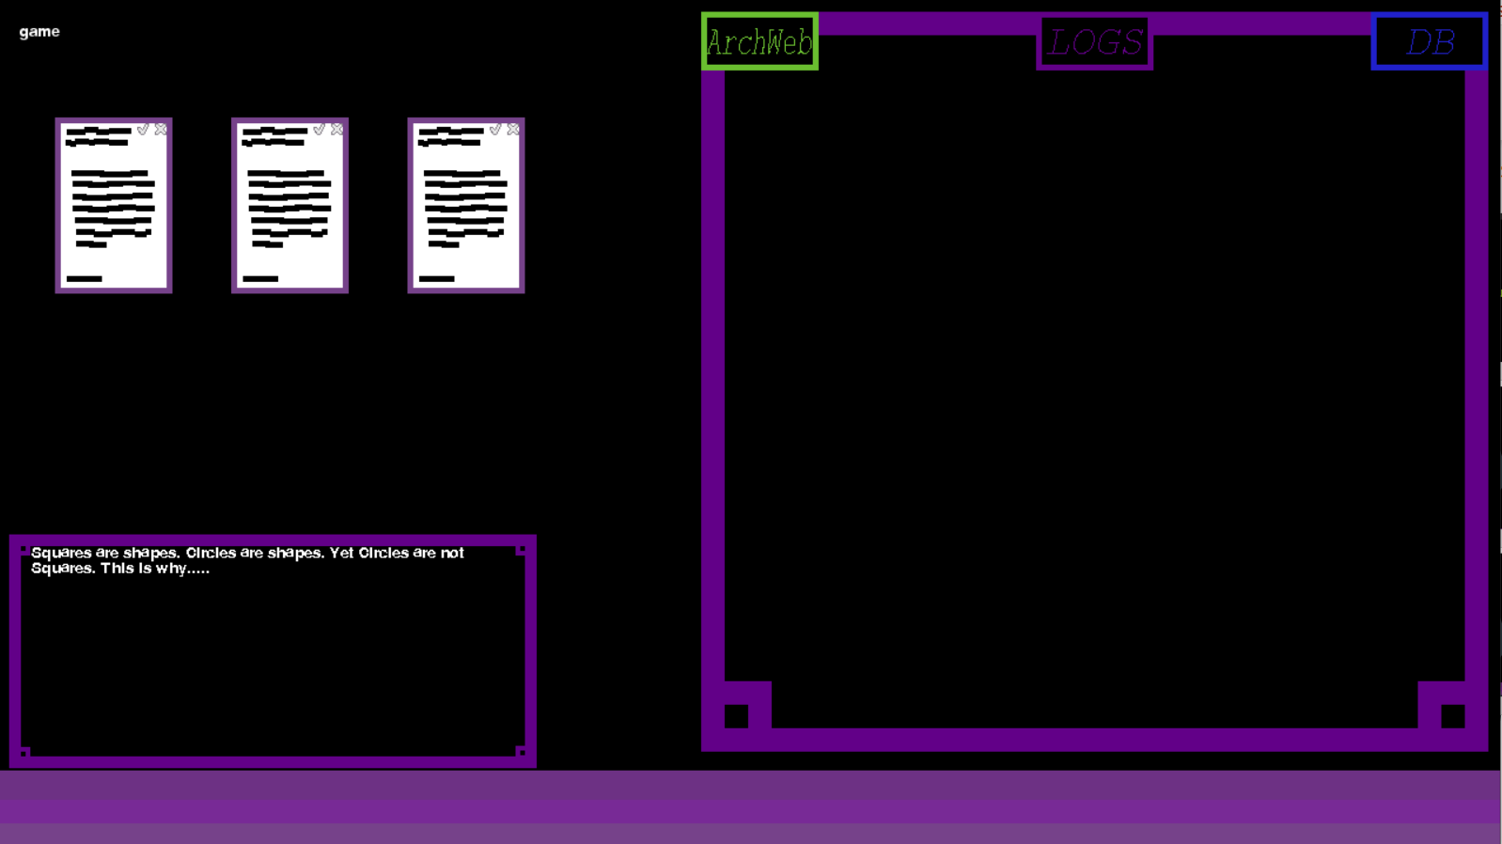
Current State as of 5/10/20

Slide 5
Road Blocks and Hurdles
SYNTAX, Syntax, syntax
Scope
Importance

Slide 6
Beyond Comp 3320
Create Percentage Bars
Finish the game’s first stage(week 1 lvls 1-5) alongside Game Loop
Code Overhaul and fixing
Research/Analysis on Misinformation (standalone Py program)
NLTK/TextBlob to generate game text data

Slide 7
Even Further
Further Incorporate Narrative Elements
Continue messing around with Python
Include More Python Libraries
If Game is Completed, investigate possible outlets to release it

